Slide 1
The enlightenment and influence of social contract theory on taxation
Cambridge Tax Discussion Group, 25 November 2021
Hans Gribnau, Tilburg University Law School
Jane Frecknall-Hughes, Nottingham University Business School
For the paper and full references, please see:
https://ssrn.com/abstract=3963285

Slide 2
overview
Introduction
Thomas Hobbes (1588–1679)
John Locke (1632–1704)
Montesquieu (1689–1755)
David Hume (1711–1776)
Jean-Jacques Rousseau (1712–1778)
Thomas Paine (1737–1809)
America, The Federalist Papers and The Anti-Federalist Papers
Concluding Remarks

Slide 3
introduction
This presentation considers some of the most important political philosophers of the Enlightenment (taken as broad concept) – thinkers whose reflections on the idea of a social contract we relate to their views on taxation. We adopt a thematic approach, considering their views on:
  the role of the state;
  the state’s relationship with its subjects/citizens;
  private property rights;
  the fairness of tax; and
  what makes tax just.
During the Enlightenment, old, long-established ideas were re-examined and demystified, with a new freedom from the religious restrictions of previous centuries.
It was a long-lasting phenomenon, and while its dates are disputed depending on the various aspects considered, it is often taken to be synchronous with the period 1688 to 1799, the so-called ‘long’ eighteenth century, although some see Enlightenment attitudes emerging as early as the late sixteenth century (at least in England).

Slide 4
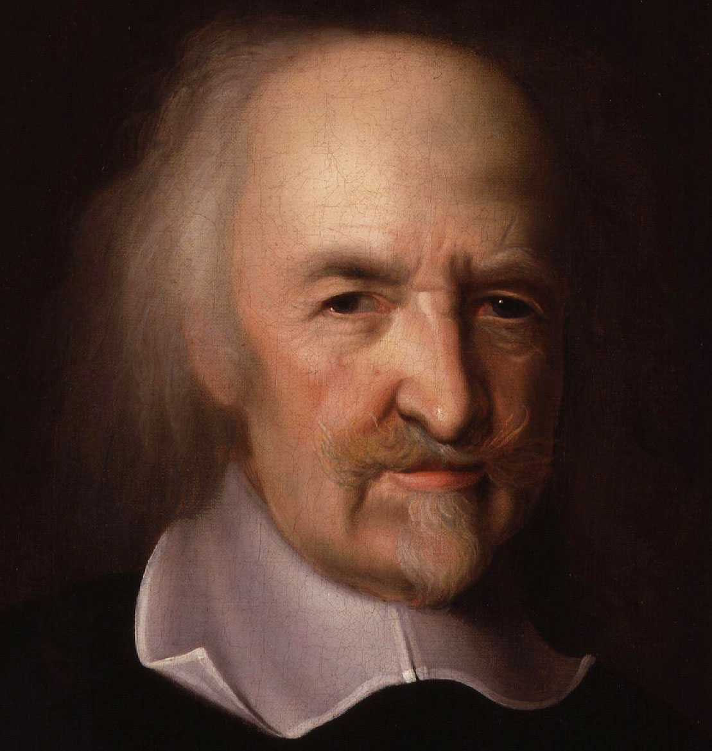
Thomas Hobbes
Was born prematurely when his mother heard of the coming invasion of the Spanish Armada. Hobbes later reported that "my mother gave birth to twins: myself and fear”.
Father was an uneducated vicar. Hobbes went to Oxford.
Hobbes served as a tutor and secretary to both William Cavendish and his son, also William (supporter of Charles I).
Published works on mathematics, physics, and (political) philosophy.
Hobbes lived in an era of religious/social unrest and wars:
  disruptive civil war fought between the king, Charles I, and parliament in 1642– 1646;
  Thirty Years’ War.

Slide 5
Thomas Hobbes: state of nature & sovereignty
Natural human inclination fuels conflict and civil war since human beings do not naturally agree and cooperate. This amounts to the state of nature, the “warre of every man against every man” (Leviathan XIII, 90).
Men agree to pass from this natural condition to a society/state. The authority of any prince “must be grounded on the Consent of the People and their Promise to obey him” (Leviathan XL, 324). Men to give up a part of their natural liberty in order to attain peace and security.
The origin of sovereign authority to command (and the obligation to obey) is rooted in a once-only social contract. The contract or covenant is concluded by self-interested individuals driven by the fear of death.
Men in the state of nature contract with one another only for their own good, and subsequently submit and transfer their rights to the sovereign/state who has almost unlimited power.
Justification for this power is the product of a thought-experiment carried out in order to understand the rights of men in the absence of any authority with the power to issues rule of conducts and settle disputes.

Slide 6
Thomas Hobbes: no natural right to property
No natural right to property since Hobbes grounds all property rights in positive law. Private property is the result of the exercise of sovereign authority;
“the introduction of Propriety is an effect of Commonwealth; [...] it is the act only of the sovereign; and consisteth in the Lawes, which none can make that have not the Soveraign Power.” Leviathan XXIV, 1 71.
It follows that the subject has a right against other subjects, but not against the sovereign; Leviathan XXIV, 172.
The belief that one can invoke a right to property against an all-powerful sovereign authority is a seditious opinion.
Nonetheless, although the sovereign is not a party to the covenant, Hobbes argues that he cannot do just as he likes. The wise sovereign has certain duties, derived not from contract, but from the law of nature. These duties derive from the fundamental duty to procure the safety of the people: “the safety of the people is the supreme law”. On the Citizen XIII, 2, 143 and Leviathan XXX, 231.

Slide 7
Thomas Hobbes: tax is the price for security
Since there is no such thing as a property right which has to be respected by the sovereign, subjects can legitimately be taxed.
For Hobbes taxes are the price of security, the enjoyment of life: “the Impositions, that are layd on the People by the Soveraign Power, are nothing else but the wages, due to them that hold the publique Sword, to defend private men in the exercise of several trades and callings” (Leviathan XXX, 238).
As all subjects benefit from the peace, they all should pay taxes. Circumstances determine the amount of taxation required, but it must be limited to the maintenance of civil peace and national security.
Nonetheless, Hobbes offers certain principles the sovereign should follow in determining the tax burden. Equality is a very important one. The burden of tax should be equally borne.
  “For a burden which would be light if all shared it, becomes heavy, and indeed intolerable, for the rest, when many wriggle out. And it is not so much the burden itself that men object to, as the inequality.’ On the Citizen, XIII, 10, 147
Equal taxation is not only in the interest of the public peace, for it is also a matter of natural law.
  It is a law of nature that in assessing others’ rights every man should treat himself as equal to every other man. Hence, sovereigns are obliged by natural law to impose the burdens of the commonwealth upon the citizens equally.

Slide 8
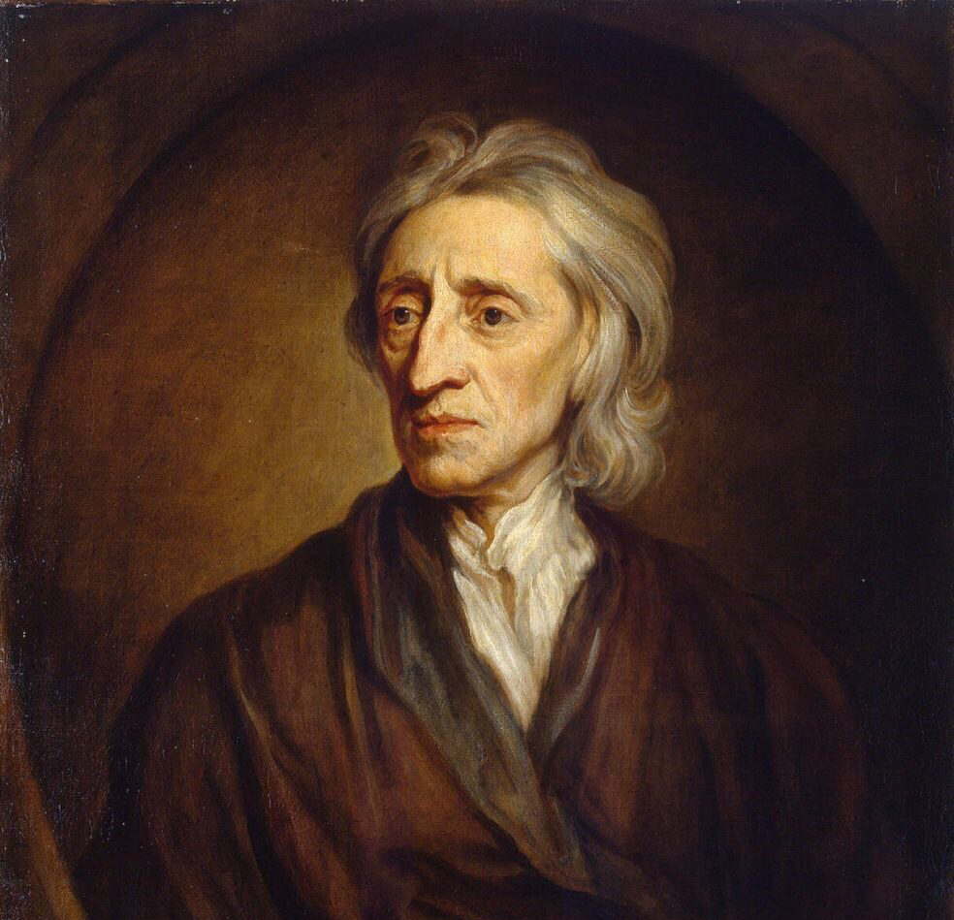
John Locke
Locke had a varied career – philosopher, Oxford don, medical researcher, doctor, government official (and spy?), revolutionary on the triumphant side in the ‘Glorious Revolution’ of 1688 (exiled because of his involvement).
He was of a Puritan background, a member of the (later) Royal Society, and a friend of Shaftesbury.
His political life was subject to constant change (he lived through the English Civil War as well) – a constant sweeping away of the old to replace it with something new (a tabula rasa), which influenced all his thinking.

Slide 9
John Locke (cont.): taxation and property
While Locke actually wrote very little on taxation, the meaning and nuances of what he did write are still debated – but clearly linked to property. Opinions on Locke’s work are often themselves controversial, with many different interpretations of his theory of property. The essence of Locke’s taxation thought appears in the Second Treatise, Chapter 11.140 – a key passage:
’Tis true that Governments cannot be supported without great charge, and ’tis fit every one who enjoys his share of the Protection should pay out of his estate his proportion for the maintenance of it. But still it must be with his own Consent – i.e. the Consent of the Majority, giving it either by themselves or their Representatives chosen by them. For if any one shall claim a Power to lay and levy Taxes on the People by his own authority, and without such consent of the People, he thereby invades the Fundamental Law of Property, and subverts the end of government. For what property have I in that which another may by right take when he pleases himself?
Some important questions arise.
  The meaning of ‘estate’ and ‘property’ – land, chattels, rights/obligations: if land, will tax fall on landowners?
  The meaning of ‘proportion’ – progressive or proportionate taxes?
  The meaning of ‘maintenance’ – tax paid in reference to income/assets or consumption? Is there a benefit principle here?
At 11.140, he is specific that “the preservation of property” is “the end of government, and that for which men enter into society”, and “the supreme power cannot take away from any man any part of his property without his own consent”: it cannot take away its subjects’ estates arbitrarily or to suit its own pleasure. This is the basis of Locke’s social contract.
For Locke, man had a natural right to own property: he could take freely from what God had given to man in common, and if he added his labour to it (e.g., ploughed a field), then that more definitely confirmed his ownership. This is still regarded as one of the most controversial of all theories of property.

Slide 10
John Locke (cont.): Locke’s version of the social contract
According to Locke (Second Treatise Chapter 5.48), no man should be subject to another’s political power unless he consents, with consent meaning that men agree with one another “to join and unite into a community for their comfortable, safe and peaceable living … in a secure enjoyment of their properties”. This is the body politic, and the individual hands over power to majority rule as the only lawful means of government – and it is tacit.
The idea that an individual voluntarily alienates his property rights in respect of tax is at odds with the idea of Locke’s right to private property. The notion that a government’s primary function is the protection of property is inherently contradicted by its simultaneous right to take it away. Thomas Hobbes, Locke’s forerunner, also felt that levying taxes was justifiable as the price of protection.
The implicit tension in these concepts remains. The distinguished American legal scholar, Richard Epstein, when considering the US tax system from a Lockean viewpoint, comments on this fundamental contradiction. Taxation coerces the surrender of property without consent – at an institutional level, aggressively attacking the citizens it is supposed to protect. The dilemma is “how to preserve the power of taxation while curbing its abuse” (Epstein 1986, 50).
Locke, when read in context, was aware of this dilemma, hence his stress on the need to adhere to a majority decision, although this could mean that a sizeable minority might disagree. He explicitly says (Part II Chapter 11.138), that a legislative power cannot act wilfully or arbitrarily, so the power to tax must be regarded as limited. In such cases (Part II Chapter 19.222), revolt by the people is justified.

Slide 11
John Locke (cont.): tax and justice
Returning to the idea of an individual handing over power to a body politic, it is reasonable that he should be willing to contribute to maintaining that body, as he will also be contributing to the protection of himself and his property (a state can protect them if required, against anyone attacking them, at law or in war).
However, this raises questions about the inherent justice of a tax system based on this concept of benefit. Locke’s system does not appear distributive at state level.
Charity, and supporting the needy were personal, not a state’s, obligations. Locke chiefly focuses on the incidence of taxation on landowners (known in advance), making this clear in Some Consideration of the Consequences of the Lowering of Interest, and Raising the Value of Money (1691).
He would have known, however, as a Registrar of Excise at one point, that excise/customs raised more than land tax, but given they were passed on to consumers who would not know how much within a price was tax, this system might be perceived as unfair.

Slide 12
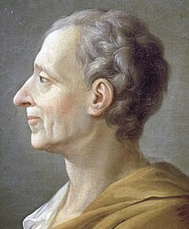
Montesquieu
Born in La Brède. Studied law at the University of Bordeaux. In 1716 he inherited the office of président in the Bordeaux Parlement; a judicial and administrative body.
Member of the Academy of Bordeaux & wrote papers on physics, physiology, geology and other natural sciences.
1721: the Persian Letters, an epistolary novel.
Voyage abroad, visit to England (1729); he attended meetings of the House of Commons and corresponded with Hume.
1731: (back in La Brède) M started working on The Spirit of the Laws.
1748: The Spirit of the Laws published.
French monarchy (‘Old Regime’): a massive, centrist bureaucratic state & major world power; perpetual need for money to pay for the wars resulted in permanent increase in taxes.

Slide 13
Montesquieu: moderate government & Law
Men living in society seems to be the natural state of affairs
Unlike Hobbes, no need for state of nature/social contract to justify absolute sovereignty which equals despotic power. Without any natural principles of equity or justice political society cannot be sustainable.
M shifts focus to conditions of good governance & institutions necessary to guarantee political liberty.
Despotism is M’s chief concern => search for moderate government.
Good legislation cannot be reduced to a command of a sovereign will (legal positivism).
“Laws, in their most general significance, are the necessary relations deriving from the nature of things, and in this sense all beings, have their laws.” Spirit I, 1, 3
Relational conception of law => legal relativism, legislation must relate “the spirit of the laws”.
“The political and civil laws of each nation should be only the particular cases to which human reason is applied” and laws should fit “the people for whom they are made” (Spirit I, 3, 8 ).
  Laws should be related to the climate, the way of life of the peoples, the degree of liberty that the constitution can sustain, to the religion of the inhabitants, their inclinations, their wealth, their number, their commerce, their mores and their manners …

Slide 14
Montesquieu: Liberty
Liberty is the right to do everything the laws permit; and if one citizen could do what they forbid, he would no longer have the liberty because the others would likewise have this same power” (Spirit XI, 3, 155).
  Laws empower citizens and protect them against constraints.
Republican conception of freedom: non-domination:
  Not negative liberty – the absence of interference from other persons or institutions.
(Political) liberty is only found in moderate states.
Only when power is not abused that one actually has the right to do everything the laws permit =>
Separation and distribution of powers prevent abuse of power.
2/3 Forms of moderate government:
  Republic (democracy or aristocracy), and monarchy
  Having their own guiding principles and mutually dependent institutions
=> Theoretical turn to reflection on different forms and levels of social justice and equality.

Slide 15
Montesquieu: Taxation
Taxes and political liberty are intimately linked:
  “The revenues of the state are a portion each citizen gives of his goods in order to have security or the comfortable enjoyment of the rest” (Spirit XIII, 1, 213).
  Reciprocity, give and take, is the normative underpinning of taxation; an ‘implicit’, semi-contractualist argument?
Amount of taxes to be paid relates to the form of government of the state and political liberty.
  They should pay in proportion to their liberty =>
  Experience shows: the more liberty citizens enjoy the greater the public revenue extracted (Spirit XIII,12, 220–221).
‘Motivational postures’ differentiation (compliance): in republics the citizen is willing to pay because “he believes he is paying to himself”; in monarchies as a “kind of reward to the prince for his respect of the laws”
M advocates limited progressive taxation.
  Each one has a physical necessity (subsistence minimum) which should not be assessed.
  Only, the “useful” [“superfluity”] that comes next to the basic physical need should be taxed, but at less than in proportion to the superfluous (Spirit XIII, 7, 217).
Nature of taxation is relative to form of government.
  Despotic regimes: poll tax; democracies: taxes instrument to redistribute wealth, preventing the rich from being too rich

Slide 16
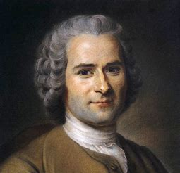
Jean-Jacques rousseau
Born in the independent Calvinist city-state of Geneva, the son of Isaac Rousseau, enjoyed the rank of citizen of Geneva, a status inherited by Jean-Jacques.
Received a haphazard education from his father and a pastor.
Published works on music, nature (botany), and (political) philosophy; contributions to the Encyclopédie of Diderot and d’Alembert.
Offers an Autocritique of Enlightenment, forcing the philosophes, to rethink their thoughts and work time and again.
Eighteenth century: increased optimism about the permanence of human societies.

Slide 17
Jean-Jacques rousseau: man is naturally good
[‘Disclaimer’: R’s political thought is rich, difficult, and perhaps even contradictory.]
Rousseau holds that man is naturally good, but society made man selfish and wicked.
  Social development, including of the arts and sciences, is corrosive of both civic virtue and individual moral character.
He takes civil society as given. He attacked Hobbes’s conception of the state of nature on the grounds that it imported features of the civil state of humanity back into the pre-civil state.
State of nature: noble savage lived basically a solitary live wandering in the woods.
  This pre-social human being is characterized by egoism (not wickedness) rather than sociability.
As human populations grow => more frequent interaction/larger communities.
The more powerful among the inhabitants claim the property of others, backed by law and state power => property is codification of (worsening) inequality.

Slide 18
Jean-Jacques rousseau: legitimate Society
Upshot of Rousseau’s story of evolution of humanity: received social contract theory (explaining the origins of society) actually tries to attribute legitimacy to a society few of its members would consent to.
R saw that social stability could be taken for a fact, most societies in his day looked quite stable.
But how to devise a legitimate society, i.e., reconcile freedom of individual with authority of state?
Self-preservation requires a form of association, that is, submission: duty to submit to an authority that may limit one’s individual pursuit of self-preservation.
  Hence, the social contract involves “a form of association” in which each citizen, “uniting with all, nevertheless obeys only himself and remains free as before” Social Contract 1,6,4.
  Essence: “[e]ach of us puts his person & all his power in common under the supreme direction of the general will; and, in a body we receive each member as an indivisible part of the whole” Social Contract 1,6,6.
  Rights, consent, contract, obligation should be reinforced by a rebirth of the civic virtue of antiquity (civil religion).

Slide 19
Jean-Jacques rousseau: Taxation
By the social contract “everyone binds himself, at least tacitly, to be assessed toward the public wants” (Discourse on Political Economy, 270).
  Taxes should be legitimately established, i.e., by the consent of the (majority of the) people or its representatives.
  If, moreover, taxes are levied at a proportional rate, taxation cannot deemed to be arbitrary.
He advocates the benefit-principle:
  taxes proportional to “the advantage that every person derives from the social confederacy” (271).
He also advocates something like the ability to pay principle:
  “He who possesses only the common necessaries of life [subsistence min.] should pay nothing at all,
  while the tax on him who is in possession of superfluities [superfluous commodities] may justly be extended to everything he has over and above mere necessaries” (272).
Thus, R calls for imposition of high taxes on wealth and luxuries by which “the poor are eased, & the burdens are thrown on the rich’,
  making it possible to “prevent extreme inequalities of fortune” (276).

Slide 20
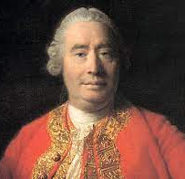
David Hume
Born near Berwick into a minor landed gentry family, Hume became a leading figure of the Scottish Enlightenment. His experience of the turmoil affecting that country – especially the financial turmoil – undoubtedly coloured his views.
Scotland had been involved in the disastrous Darien schemes (colonies in Panama). This lessened resistance to formal political union with England in 1707. There were the various Jacobite rebellions (1689–1692, 1715, 1719 and 1745); the South Sea Bubble had burst in 1720; the Bank of England had been established (1694) and the National Debt to fund Britain’s wars, notably the War of the Spanish Succession (1702–1713) and the War of the Austrian Succession (1740–1748).
Friend of Rousseau, with whom he quarrelled, and of Franklin – and better known in his own lifetime as a historian.

Slide 21
David hume (cont.): property and the destruction of the social contract
The development of Hume’s thoughts is difficult to unravel as he frequently revised his works, which makes it hard to detect any sequential evolution. His body of work on moral and political philosophy is extensive and often repetitive.
The destruction of the Lockean concept of the social contract and natural rights is widely attributed to Hume, although many scholars have rejected these ideas, especially Jeremy Bentham, to whom the idea of natural rights was an anathema.
There is no natural right to property, as Hume says in Section 3, Part II of An Inquiry Concerning the Principles of Morals:
[A]ll questions of property are subordinate to the authority of civil laws, which extend, restrain, modify, and alter the rules of natural justice, according to the particular CONVENIENCE of each community. The laws have, or ought to have, a constant reference to the constitution of government, the manners, the climate, the religion, the commerce, the situation of each society.
For Hume, the idea of property originates from man’s natural condition, which is beset by competition and conflict. Common or mutual interest therefore leads to the notion of property rights, to protect the public interest, create stability and consent in respect of property transfer, but these are artificial rules, based on human practice and serve a function.

Slide 22
David hume (cont.): property and the destruction of the social contract (cont.)
Hume argued that government is most commonly established by violent means (because of shortages in resources) . In his work, Of the First Principles of Government (1741), he bases the foundation of government on two needs: to protect public interest and the rights to property and justice. Human weakness, especially the tendency towards conflict, prevents individuals from acting justly, so a government is needed to help establish a duty of obedience, to maintain law – but such authority must also be balanced against the need to maintain liberty.
In Of the Original Contract (1748) Hume is critical of social contract ideas, particularly objecting to their inherent notions of tacit consent, as the latter ignores the fact that many people may live under a government simply because they cannot leave.
Hume has no truck with natural law. In his Treatise of Human Nature (Book 3, 3:1), a fact or law of nature, for example, such as a man needing food without which he would die, does not confer a ‘natural’ right to food: there is a gap between ‘is’ and ‘ought’, in Humean terms.

Slide 23
David hume (cont.): taxation, and the relevance of custom
In Lockean theory, the concept of the social contract was key in underpinning the legitimacy of imposing taxation, so without this, how does Hume justify the imposition of taxes by a government, given his views on maintaining liberty?
His thoughts on taxation are found disseminated among his many writings. He did write one work on taxation (Of Taxes, 1752), but this is not theoretically based (see later). although there are indications of his thinking scattered throughout his work, especially in his moral theory, in Book 3 of the Treatise of Human Nature (1739–1740) and in An Inquiry Concerning the Principles of Morals (1751), where he discusses the nature of justice and man’s motivation to act justly, especially in relation to property.
A sense of justice is not innate, but is derived from self-interest, convention and education. If man depends on society to survive, it is in his interest to respect others’ property so that society remains stable and intact. Such behaviour imbues man with a common interest, and anticipation that others will behave similarly, thus engendering a respect for rules and a sense of civic duty. It is a not a huge leap in thinking to suggest that imposing and paying tax might be an anticipated part of civic duty and support for a desired society.
The idea of convention or custom permeates Hume’s work. In An Inquiry Concerning Human Understanding (1748), Hume says (with some similarity to Locke’s ideas) that human knowledge is based on impressions and ideas, which then become bound together – and accepted.

Slide 24
David hume (cont.): taxation, and the relevance of custom (c0nt.)
In the context of taxation, this might mean that man accepts taxation simply because it has been customarily developed. One deals with what exists, and there is no need to speculate why it exists, although this does not mean that things cannot be changed, as Hume makes clear in his work Of the Original Contract (1748, 275–276):
When a new government is established, by whatever means, the people are commonly dissatisfied with it, and pay obedience more from fear and necessity, than from any idea of allegiance or of moral … Time, by degrees, removes all these difficulties, and accustoms the nation to regard, as their lawful or native princes, that family, which, at first, they considered as usurpers or foreign conquerors.
This may explain Hume’s view of taxation as shown in his essay Of Taxes (1752). As noted, this does not consider taxation theory in any way: rather, it is strongly practical, although somewhat inconsistent. Gribnau and Dijkstra (2020, 81) comment that Hume’s ideas about taxation “resemble more an assemblage of separate thoughts than a consistent exposition on taxation”.
Hume is aware that not all customs are beneficial, particularly in reference to taxation. Well established governments, notably monarchies, can degenerate because of excessive debts and taxes, and he cites in this regard in Of Civil Liberty (1741, 54), the instance of France.
The fairest taxes are those on (luxury) consumption – expensive to levy, perhaps, but convenient to pay – while the worst are arbitrary taxes (Of Taxes, 1752). Hume does not, however, deal with the issue of establishing a public finance system appropriate to a free, commercial society.

Slide 25
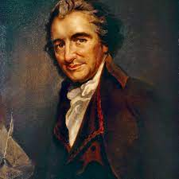
Thomas paine
A very radical thinker, Paine’s contribution to taxation theory is often overlooked, although tax is frequently mentioned in his revolutionary writings.
He started out on a career as an exciseman, but was dismissed for involvement in agitation to increase excisemen’s pay. He would have experienced practical issues in regard to taxation, notably smuggling to avoid high taxes on luxury goods such as tea, textiles, etc.
He was actively involved in America’s struggle for independence from Great Britain, publishing pamphlets in support of this cause, notably Common Sense (1776) and a series known as The American Crisis (or The Crisis) (1776–1783).
He is best known for The Rights of Man (1791 and 1792), moving to France when he heard he was about to be arrested for sedition. An active participant in the Revolution, he was a member of the Convention, but his opposition to the execution of Louis XVI saw him imprisoned and narrowly escaping execution. He returned to America in 1802, dying there in penury in 1809.

Slide 26
Thomas paine (cont.): paine’s version of the social contract
Part I of The Rights of Man was primarily a response to Edmund Burke’s Reflections on the Revolution in France (1790), in an attempt to defend the French Revolutionaries. Paine was frequently at political loggerheads with Burke.
Burke opposed the revolution in France, feeling that changes to a complex and intricately linked societal order should be made gradually: it is not based on any kind of contract. To sweep all that away in favour of untried revolutionary doctrines denies the reality of human association and is an offence against nature. This is the basis of Burke’s disagreement with Paine.
Paine’s particular innovation was to set out the role of government in a society where morality took precedence over economics, his idea being to reform governments that had become tyrannical and corrupt with the passage of time.
Reform, for Paine, involved three stages – political education, then political action, and finally changing social and economic conditions for the better. Political action encompassed revolution, which was a means to end oppression and burdensome taxation. He would sweep away the problems of the past and start anew.
Much like Locke, Paine saw society as based on natural rights, with a kind of social contract giving rise to government, but Christian (1973) sees this as based on economic need, as men cannot be self-sufficient and need state protection to combat economic aggression.
Paine considered that all men should participate in government and have the right to provide some input into public affairs: they were given this right because they paid tax.

Slide 27
Thomas paine (cont.): extension of the idea of benefit
Paine speaks extensively about taxation in The Rights of Man, Part II, commenting on its oppressiveness, especially in regard to taxes on consumption and the burden they created for the industrial and agricultural poor (mentioning especially beer)..
Significantly, in Part II, Paine also gives many details about English taxation (an approach he similarly adopted in his earlier writing on taxation (Pamphlet 9b The Crisis Extraordinary. On The Subject of Taxation, written in Philadelphia in 1780)), but the source of this information is not provided. Starting with William the Conqueror, he gives amounts of taxes raised, culminating in a figure of £17,000,000 for 1791, with increases over the years driven by extravagance, corruption and wars.
He also estimates £9,000,000 would be needed to service interest on the National Debt, with £8,000,000 set aside for other costs, including £1,000,000 for the armed forces.
He sets out uses of tax revenue to pay old age pensions, for education, birth, marriage and work travel allowances, employment of the casual poor, and for disbanded army and navy personnel – but does not really address how this might be funded other than by a graduated income tax (to replace house and window taxes and the commutation tax).
Paine went a long way in developing tax theory – extending the idea of natural rights to education and financial support – in which lies the beginnings of benefit theory and, possibly, a blueprint for a welfare state. He was years ahead of his time.

Slide 28
America, the federalist papers and the anti-federalist papers
The theme of the development of America and the United States is evident in the work of a number of the philosophers considered earlier – Locke, Hume, Burke and Paine – and especially in reference to tax.
As regards the French Revolution, resentment was felt was at taxation’s unevenness and unfair impact: in essence, an income tax was desired which would apply to all citizens, regardless of status and not exempt the rich, who could afford most but paid the least tax, if any at all.
In contrast, when Great Britain decided that American colonists should contribute to their own protection, a series of taxes followed – the 1765 Stamp Act, which colonial riots forced to be cancelled, with the 1767 Townshend Acts introducing additional duties and generating further riots, culminating in the 1773 tea duties and the famous ‘Boston Tea Party’ and subsequent Coercive Acts in 1774.
While the colonists initially did not want independence (just greater control over their own affairs, especially taxes), Thomas Paine’s Common Sense of 1776 was instrumental in promoting the view that the colonists owed nothing to Britain. Common Sense was a radical, reasoned polemic, arguing convincingly against British monarchical rule and for separation of America from Great Britain, and was enormously influential in turning public opinion towards independence.
By the time of the ‘Boston Tea Party’, the amount of tax payable was actually minimal, but the principle of it being imposed without the consent of those taxed was the issue. The War of Independence ended in 1781, with a peace treaty being formally signed at Versailles in September 1783 – leaving the 13 newly independent states in need of a constitution.

Slide 29
America, etc. (cont): The influence of the philosophers
It was to earlier theorists that many of the US Founding Fathers turned for political guidance in their search for principles on which to found a new state with a written constitution. Arguably, the influence of Locke was the most predominant.
It is not surprising to find this, given the circumstances pertaining. After all, a new nation was being forged, and all of the old institutions had been swept away, so who better as an inspiration than Locke who had had similar experiences, and whose view of America was one that would resonate with those descended from American pioneers?
Locke had known a great deal about America, from reading about travel, geography and explorations, from his investments in colonial ventures and from his public service.
Locke used America to provide key examples in the development of his political theories, particularly the right to private property – a use which has always been considered controversial and has generated much debate on the positions of the Amerindians, English, European and other colonists.
It is easy to be critical of Locke’s use of America, but many of his contemporary readers would not have known much, if anything, about America. It is often the case that a far away, largely unknown country is used to provide cautionary or illustrative examples.

Slide 30
America, etc. (cont): The influence of the philosophers (cont.)
It is equally easy to point to inconsistencies and omissions, for example, that the concept and practice of slavery could not be encompassed within his theories.
Dienstag (1996a, 1996b) shows that of the American Founding Fathers, Jefferson and Adams alike were particularly influenced by Locke’s political thinking in the Second Treatise, which resonates in Jefferson’s original drafting of the Declaration of Independence:
We hold these truths to be self evident: that all men are created equal; they are endowed by their Creator with inherent and inalienable rights; that among these are life, liberty, and the pursuit of happiness; that to secure these rights, governments are instituted among men, deriving their just powers from the consent of the governed; that whenever any form of government becomes destructive of these ends, it is the right of the people to alter or abolish it, and to institute new government, laying its foundation on such principles, and organizing powers in such form, as to them shall seem most likely to effect their safety and happiness. (Jefferson 1903, 1, 29)
Dienstag (1996a) makes very clear, however, that the exact nature of Locke’s influence has been extensively debated. Many writers also consider Hume and other, ancient Greek and philosophers had their part to play (evident in Alexander Hamilton’s thinking – see later).

Slide 31
America, etc. (cont): The move to an explicit contract
Likewise, Locke’s Second Treatise influenced the writers of The Federalist Papers – a set of essays and articles written by Founding Fathers James Madison, Alexander Hamilton and John Jay, and published collectively under the pseudonym ‘Publius’, although the various pieces have subsequently been attributed to specific authors. Their purpose was to promote acceptance of the Constitution developed in 1787 after the War of Independence, and explain and justify the political principles it embodied.
Key – and highly controversial – issues were the separation of powers between the judiciary, the legislature and the executive, and the concept of federalism. Post-war debt and tax continued to rise and limiting the power of the legislature was regarded as particularly important.
The works of many philosophers had influence – Locke, Hume, Montesquieu, also classical authors.
The Federalist Papers, numbers 30 through to 36, attributed to Alexander Hamilton, concern taxation. Overall, Hamilton aimed to persuade readers that there should be federal taxation, at a national level – that there should be a general power of taxation (No. 30) to provide public necessities – a concept that was repeated in other articles, although he was not opposed to individual state taxation (Nos. 32 and 33). .
Particularly vexing issue was the nature of the relationship between state tax law and any federal imposition and their respective standing. Hamilton was concerned to point out that two sets of tax laws could co-exist harmoniously, and would exist to serve different purposes. For example, federal revenue would be necessary to deal with future contingencies of a national character, such as war, as well as national government administration.

Slide 32
America, etc. (cont): The move to an explicit contract (cont.)
The views of the Federalists were countered by the Anti-Federalists, who were opposed to the ratification of the Constitution.
They too were in favour of federalism, but wanted a ‘small republic’ (a weak central government), as opposed to a ‘big republic’, fearing that a national government would have too much power and would be a threat to individual liberties. To counter this latter threat, they wanted a bill of rights.
They were concerned especially about the effect on state government if a national government were too powerful, the potential for a president to have monarch-like powers and a congress to seize too much power, as well as having concerns about a system of federal courts. In general too, they considered that the actual size of the combined US states would mean that a republican-style government could not operate effectively.
The Anti-Federalist Papers are liberally peppered with detailed arguments about taxation, with numbers 30 to 36 being devoted entirely to tax. A particular concern was about the federal power to tax, which they wanted limited to taxing imports from overseas.

Slide 33
America, etc. (cont): The move to an explicit contract (cont.)
The Constitution was ratified, albeit by a very narrow margin, but taxation continued to be contentious.
It is, perhaps, not easily appreciated today just how radical and contentious the US Constitution was when it was first drafted, as the countries of the known world were still predominantly governed by monarchical powers, sometimes absolute.
There was no frame of reference for such a written document but hitherto just philosophical ideas. The Founders had indeed started with a tabula rasa, scraped clean of past ideas and associations. What they did was move from the tacit social contract idealised by Locke and develop an explicit, written version (particular to the circumstances of 13 states which had fought a war to achieve independence) which defined government power, specific rights, obligations and expectations in a way that had not been done before – and particularly as regards taxation.

Slide 34
Concluding thoughtS
The principle underpinning the distribution of the tax burden evolves with the views by the different philosophers on the type of government advocated.
The emphasis seems to shift from the grounding of political authority and obedience on the need for security and the protection of property, to the preconditions for legitimate government and governance:
  legitimate government and governance should be capable of protecting and enhancing individual liberty and equality.
This development clears the way for more egalitarian notions of taxation, going beyond the distribution of the tax burden based on the benefits secured by government.
As principles of equity or justice come to the fore as preconditions for any sustainable political society, tax becomes instrumental to social justice.
The benefit principle is past its peak and the ability to pay principle, embodying the concept of distributive justice (along with a different conceptualisation of rights), enters the scene.
Nevertheless, it will be a long way to go towards legitimate governance, a just, inclusive political society and a corresponding tax system.

Slide 35



THANK YOU FOR LISTENING.
QUESTIONS?

